Slide 1
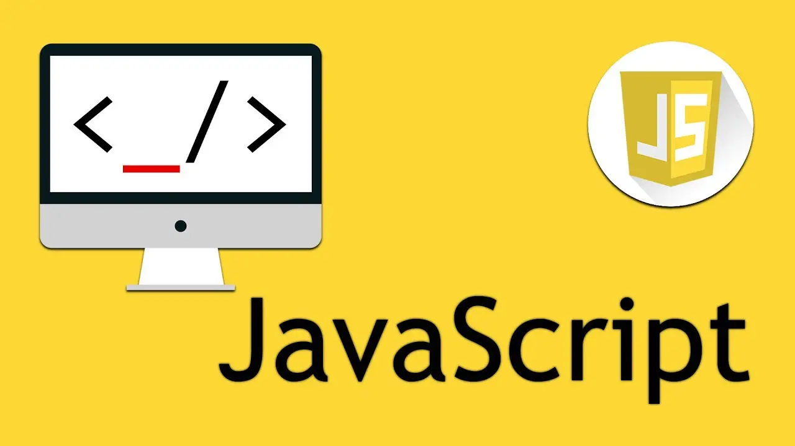

Slide 2
DAY-01
Topics Covered : –
What is Javascript?
Why we need Javascript?
History of Javascript
JS Engines of different browser
Characteristics of Javascript
Ways to add Javascript
Variables in Javascript
Datatypes in Javascript
Operators in Javascript
Decision-Making Statements in Javascript

Slide 3
What is JavaScript
JavaScript is a high level programming language which is used to create interactive web pages.
It is the only language understood by browser.
JavaScript is a scripting language.
It is the language you can use at browser side as well as server side.
It is the most commonly and popular language used right now.
A lot of framework and libraries are based on Javascript. It can be used for both frontend and backend.
Frontend – React.Js, Angular.Js, Next.Js
Backend – Node.Js, Express.Js

Slide 4
Why We using the js?
We use JavaScript (JS) because it makes web pages interactive.
Without JS:
A website is just static—it only shows text and images but doesn’t respond when you click buttons or type something.
With JS:
You can create dynamic content (like pop-ups, forms, and animations).
It lets users interact (click, scroll, type, play music, etc.).
It works in the browser without needing extra software.
Basically, JS makes websites alive instead of just looking like a book.

Slide 5
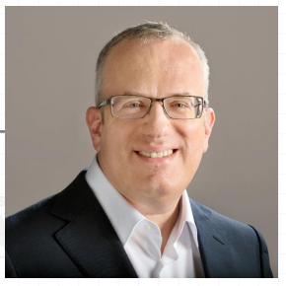
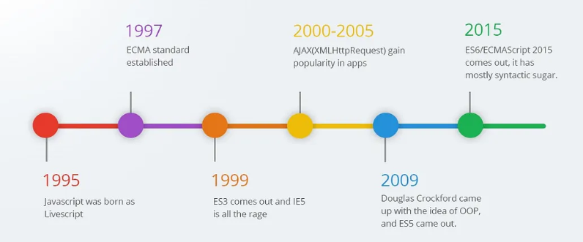
History of JavaScript (JS)
1995 – Brendan Eich created JavaScript in just 10 days while working at Netscape.

Slide 6
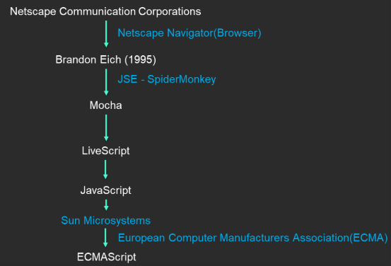
History of JavaScript (JS)

Slide 7
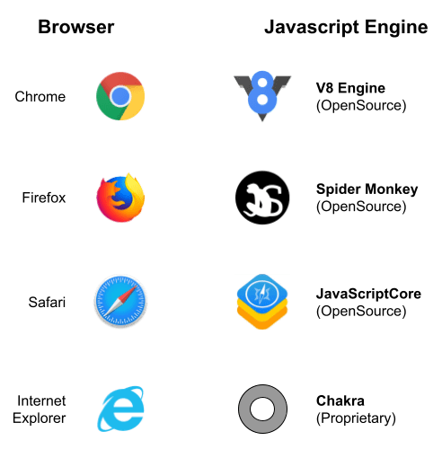
JS Engines of Different Browser

Slide 8
Characteristics of JavaScript
Client-Side Scripting Language
Dynamically Typed Language
Weakly Typed Language
Interpreted Language
Synchronous in Nature (Single-Threaded)

Slide 9
Characteristics of JavaScript
Client-Side Scripting Language:
Runs inside the browser (Chrome).
No need for a server to process every action.
Example: Clicking a button changes text instantly.
2. Dynamically Typed Language:
No need to define variable types (number, string, etc.).
JS automatically detects the type at runtime.
3. Weakly Typed Language:
Allows operations between different data types.
Can cause unexpected behavior.
Example: (String + Number = String), (String - Number = Number)
4. Interpreted Language:
Executes line by line in the browser (no need to compile).
Easier to debug but slightly slower than compiled languages.

Slide 10
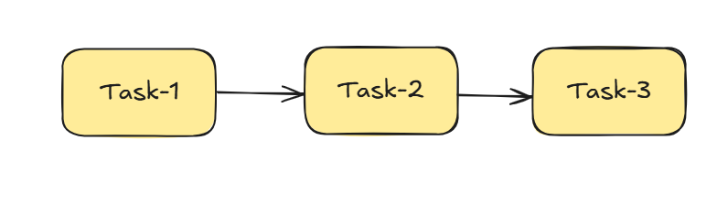
Characteristics of JavaScript
5. Synchronous in Nature (Single-Threded):
Executes one task at a time in order.
Can cause delays if one task takes too long.
Example:
console.log("First");
alert("Pause here...");
console.log("Second"); // Runs only after alert is closed
But JS also supports Asynchronous tasks (like setTimeout & fetch) to handle multiple things smoothly!

Slide 11
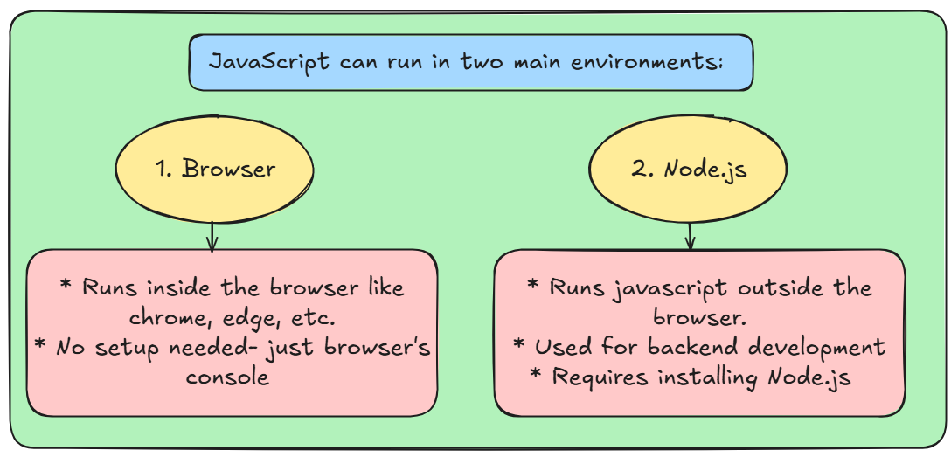
Ways to Run JavaScript Code (Environment Setup)

Slide 12
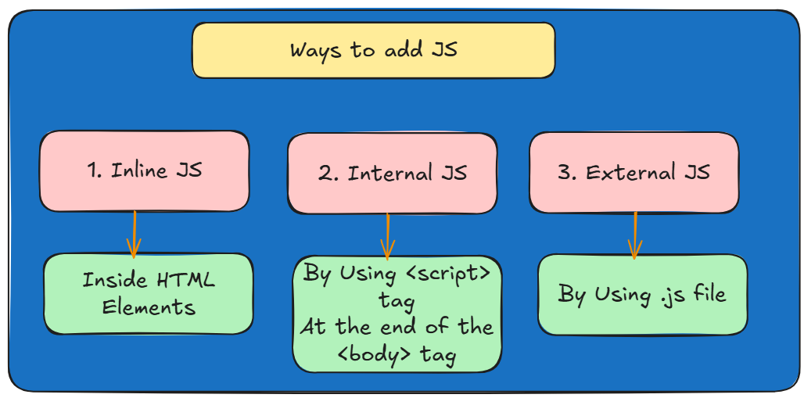
Ways to Add JavaScript to a Webpage

Slide 13
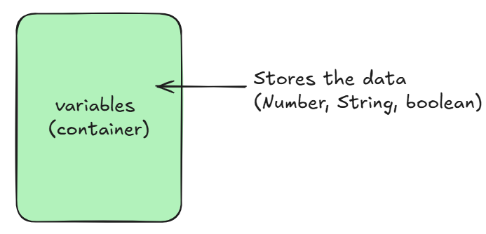
Variables in Javascript
Q. What is a Variable in JavaScript?
A variable is like a container that stores data.
It holds values that can be used and changed in a program.
Types of Variables in JavaScript:
var
let
const

Slide 14
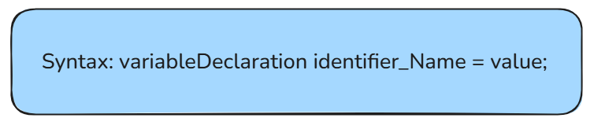
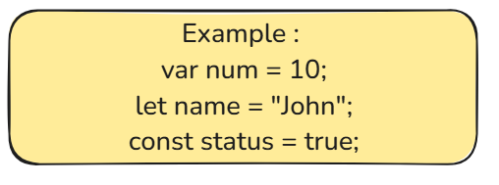
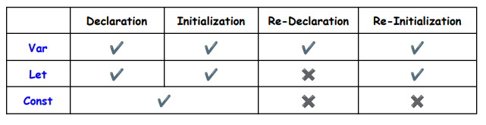
How to declare the variable

Slide 15
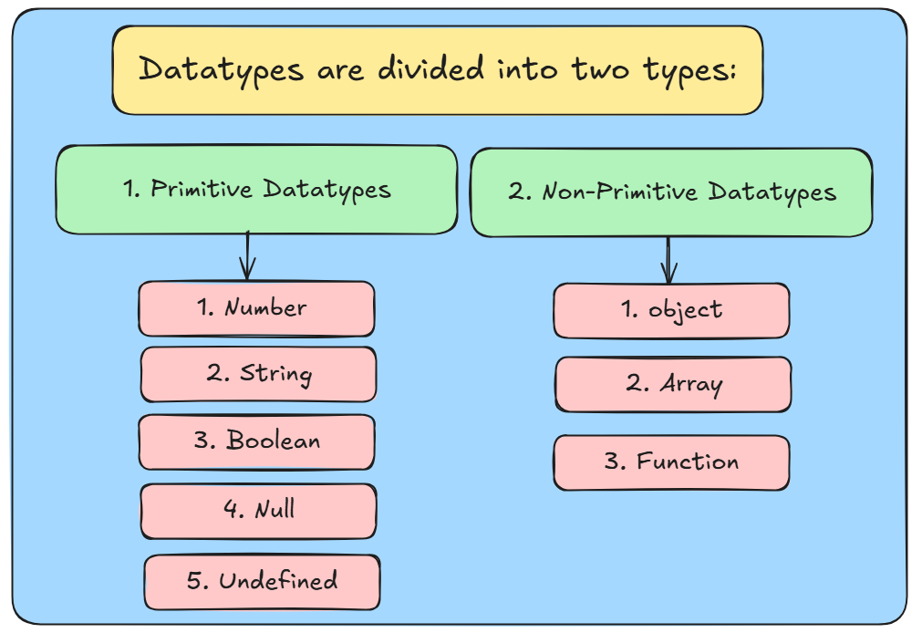
Datatypes in javascript

Slide 16
Primitive Datatypes
Number: It is the values which may be integers or decimal. (Ex: 10, 5.5, 3,27, etc)
String: It is the combination of characters. And it is enclosed between Single-quotes (‘’), Double-quotes (“”). (Ex: “Hello”, “123”, etc.)
Boolean: It represents true or false values. True means (one-1) and false means (Zero-0). (Ex: true or false)
Null: Means nothing or empty value but not zero (0).
Undefined: A variable that exists but has no value assigned yet.

Slide 17
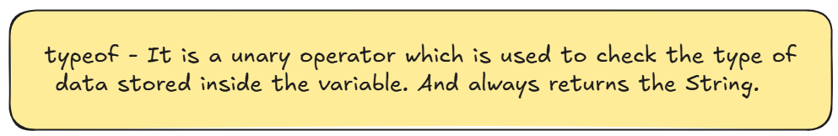
Non-primitive Datatypes
Object: A collection of data which is stored in the form of key-value pairs.
Array: A collection of data that stores multiple type of data.
Function: A reusable block of code designed to perform specific task.

Slide 18
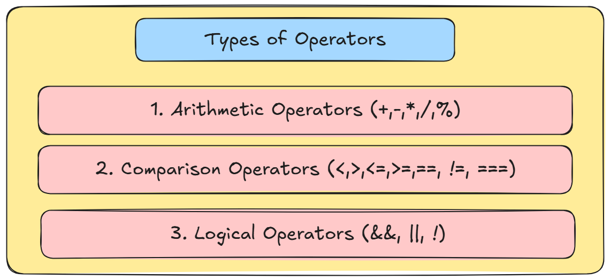
Operators in javascript
Operators are predefined symbols which is used to perform some specific tasks.

Slide 19
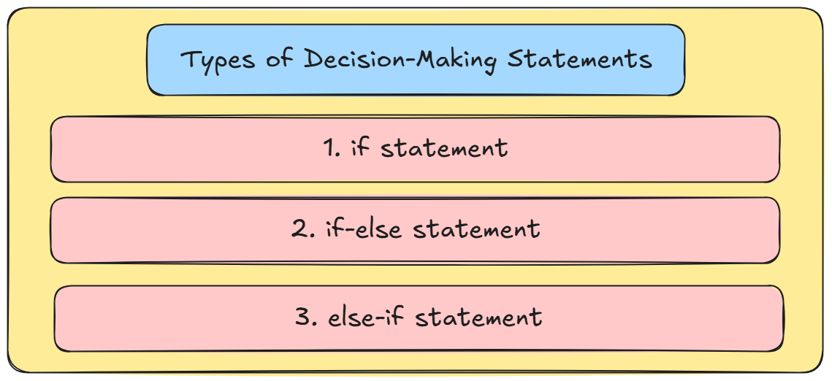
Decision-statements in js
A decision-making statement in JavaScript helps the program decide what to do based on conditions.
It checks if something is true or false and then runs specific code.

Slide 20
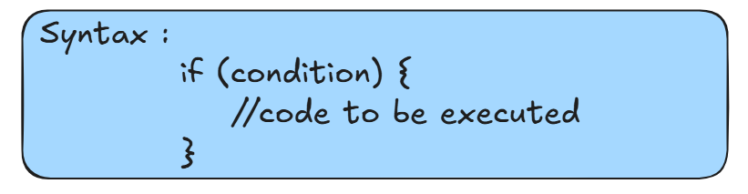
If-statement
If-statement: It will runs when the condition is true only.

Slide 21
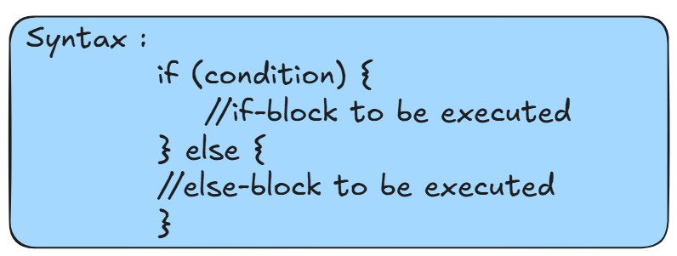
If-else statement
If-else statement: It will runs different true or false. If condition is satisfied then it will execute the if block or condition is false then it will execute the else block respectively.

Slide 22
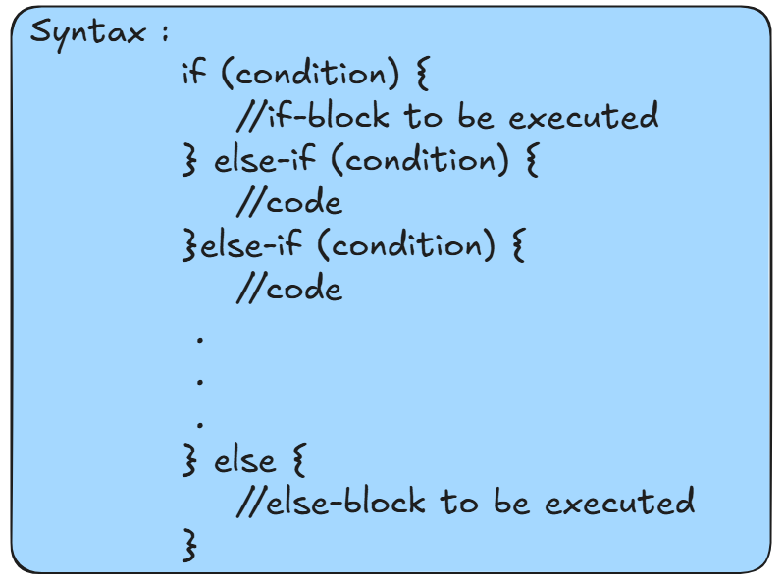
Else-if ladder statement
Else-if ladder: It will checks the multiple conditions.

Slide 23
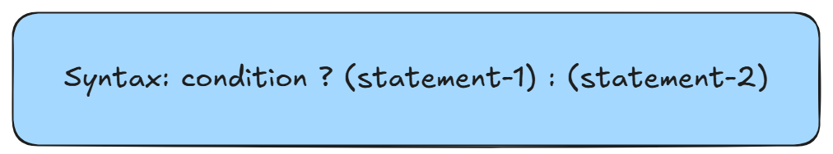
Conditional / Ternary operator
Ternary Operator: The ternary operator in JavaScript is a shorthand way of writing an if-else statement.
It is also called the conditional operator and uses the ? : syntax.
If the condition is true -> statement-1 will be executed
If the condition is false -> statement-2 will be executed

Slide 24
DAY-02
Topics Covered : –
Looping Statements
For-loop
While-loop
do-while loop
Functions in Javascript
What is Function?
How to declare functions
How to call or invoke the function
What are parameters and arguments in functions
3. Types of Functions
Named Function
Anonymous Function
Arrow Function
Callback Function
Higher-Order Function (HOF)

Slide 25
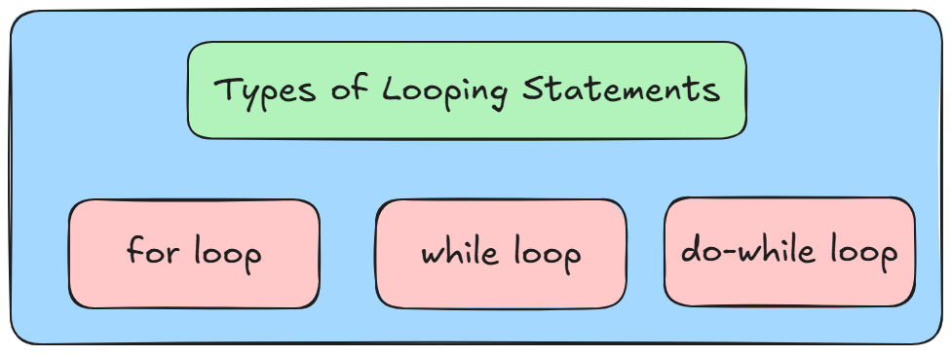
Looping statements
Looping Statements: A looping statement is a way to repeat a block of code multiple times based on a condition.
This helps in doing repetitive tasks.

Slide 26
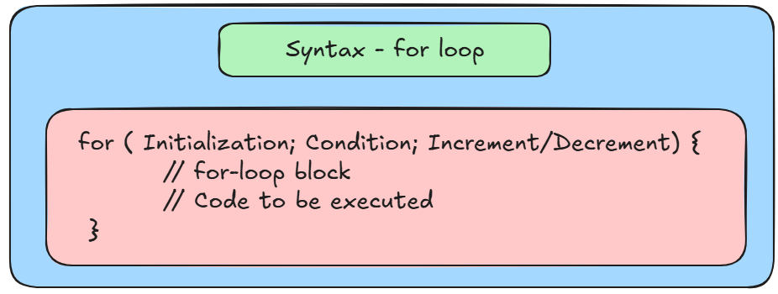
For-loop
For-Loop: A for loop is used when you know how many times you want the code to run.
It includes three parts:
1. Initialization
2. Condition
3. Increment/Decrement

Slide 27
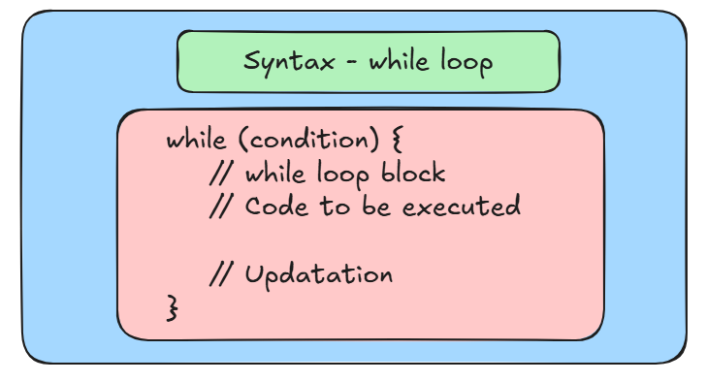
While-loop
While-Loop: A while loop runs as long as a condition is true. If the condition is false from the start, it won’t run.

Slide 28
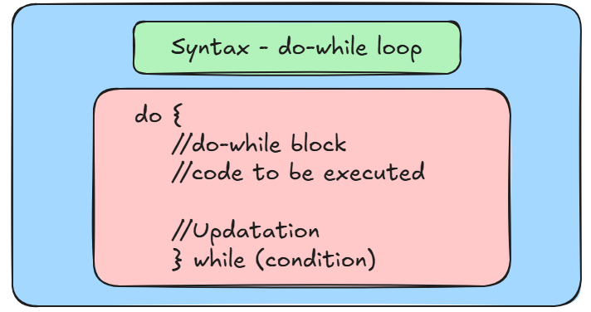
Do-While loop
Do-While Loop: A do-while loop is similar to the while loop but it runs at least once.

Slide 29
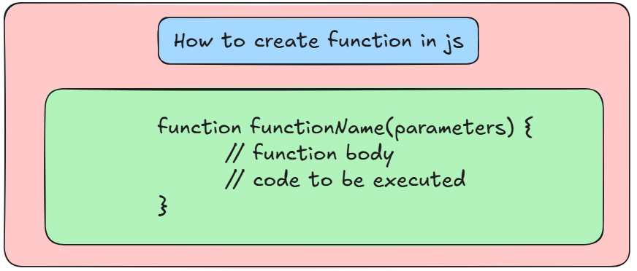
Functions in javascript
Function: A function in javascript is block of code written to perform a specific or particular task.
It is executed when it is called or invoked.
Functions help to avoid repetition of code and make it reusable.

Slide 30
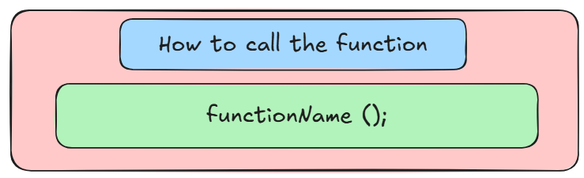
Functions in javascript
Function Call Statement: A function call statement is the part of the program where function is called, meaning the function is executed.
A function call is the action that triggers that block of code.
To call a function, you simply use its function name and followed by parentheses. ()

Slide 31
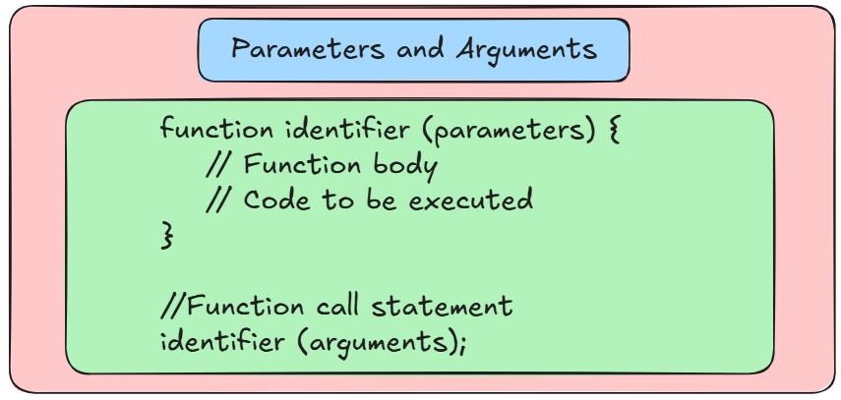
Functions in javascript
Parameters: A parameter is a variable defined in a function’s definition.
Arguments: An argument is the actual value that is passed to a function when it is called.

Slide 32
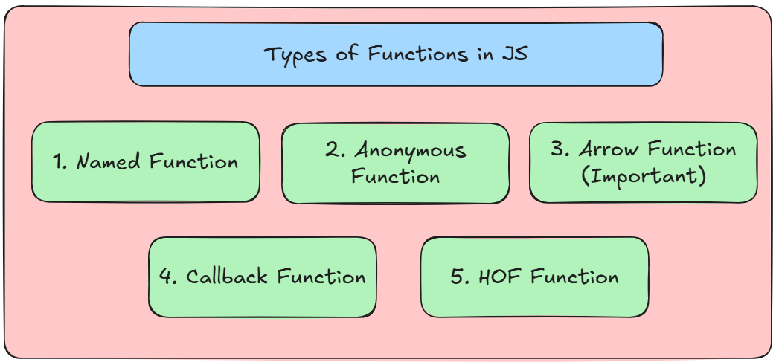
Types of Functions in javascript

Slide 33
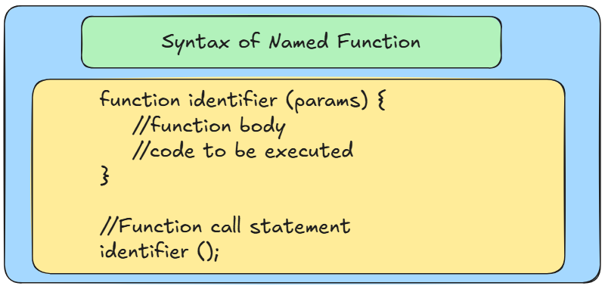
1. Named Function
Named Function: A function that is defined with a name is called as Named Function.
It is also called as Function Declaration.

Slide 34
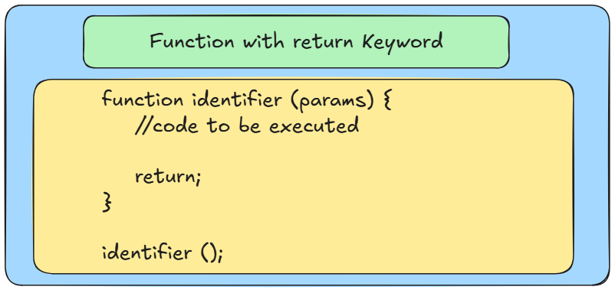
What is return Keyword in Function?
return Keyword: The return keyword is used to send a value from a function back to the caller.
NOTE: It should be the last statement inside the function after that function execution will be stopped.

Slide 35
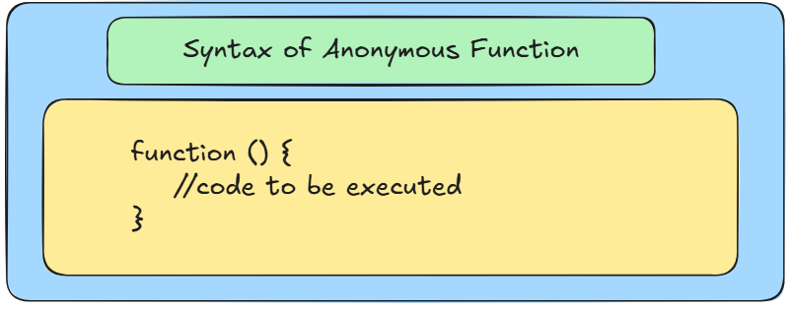
2. anonymous Function
Anonymous Function: An anonymous function is a function that does not have a name.
Q. How to call or execute the Anonymous Function?

Slide 36
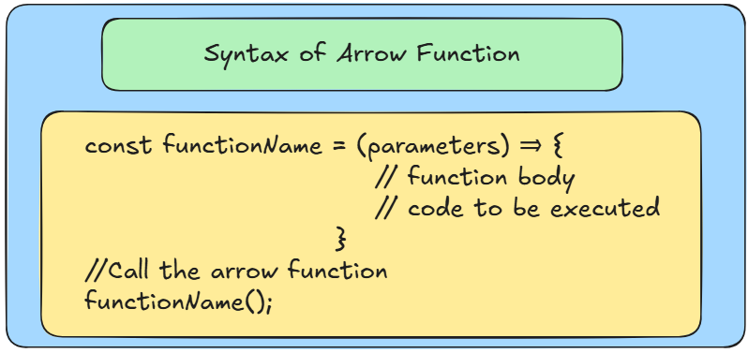
3. arrow Function
Arrow Function: Arrow functions are a shorter way of writing functions.
It is especially useful for anonymous functions.
It is also called as Fat Arrow Function which is introduced in the ES6 version in the year of 2015.

Slide 37
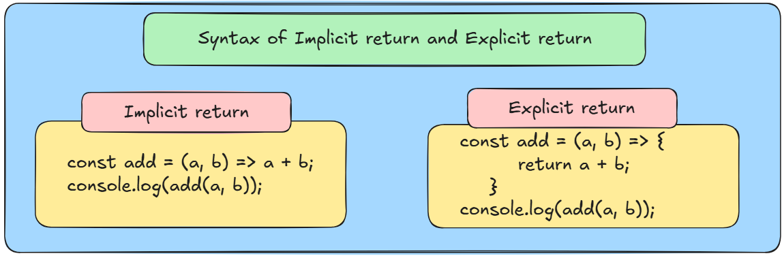
return keyword in arrow function
1. Implicit Return: If the function has a single statement, you can omit the return and curly braces {} .
2. Explicit Return: If there are multiple statements, you need to use explicitly and you have to use curly braces {} mandatory.

Slide 38
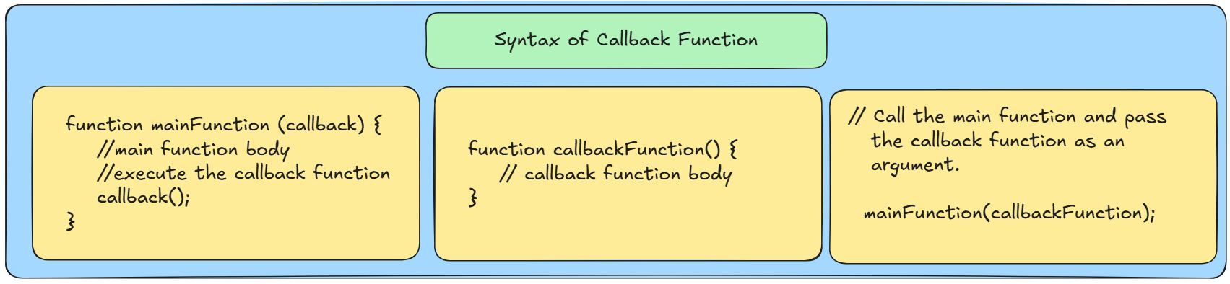
4. Callback Function
Callback Function: A callback function is a function passed into another function as an argument, is known as callback function.

Slide 39
5. HOF Function
HOF Function: HOF stands for Higher-Order Function in Javascript.
A higher-order function is a function which accept a callback function as arguments that function we called as Higher-Order Function.

Slide 40
DAY-03
Topics Covered : –
Strings in Javascript
What is String?
How to declare strings
String Methods
Arrays in Javascript
What is Array?
How to create array?
How to access the array elements
Array Methods

Slide 41
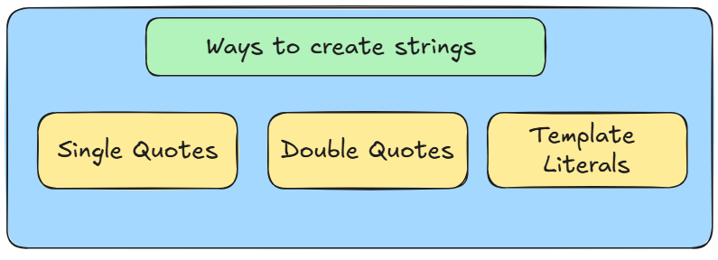
Strings in javascript
String: String is the collection of characters.
Strings are immutable, means their content cannot be changed once created.

Slide 42
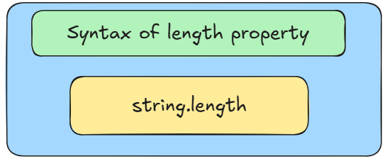
String – length property
length: The length property is used to determine the number of characters in a string.
It includes spaces, special characters, alphabets, etc.

Slide 43
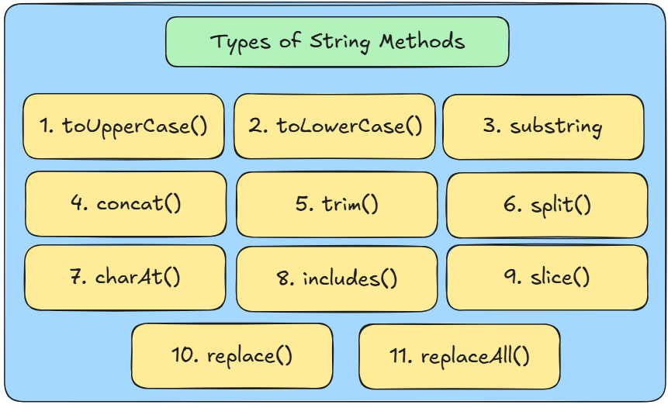
String Methods in javascript

Slide 44
String Methods in javascript
toUpperCase(): Converts a string to uppercase.
Syntax - string.toUpperCase();
toLowerCase(): Converts a string to lowercase.
Syntax - string.toLowerCase();
substring(): Extracts a part of a string between two specified indexes.
Syntax - string.substring(startIndex, endIndex);
concat(): Concatenates one or more strings and returns a new string
Syntax - string.concat(str1, str2, …);
trim(): Removes whitespace from both ends of a string
Syntax - string.trim();

Slide 45
String Methods in javascript
6. split(): Splits a string into an array based on a specified separator.
Syntax - string.split(separator); [separator – “”, “ “, “ “]
7. charAt(): Returns the character at a specified index (only positive index allowed).
Syntax - string.charAt(index);
8. includes(): Checks if a string contains a specified substring
Syntax - string.includes(substring);
9. slice(): Extracts a section of a string and returns it as a new string.
Syntax - string.slice(startIndex, endIndex);
10. replace(): Replaces the first occurrence of a specified substring with another.
Syntax - string.replace(searchValue, newValue);
11. replaceAll(): Replaces all occurrences of a specified substring with another

Slide 46
arrays in javascript
Array: An array is a collection of multiple values stored in a single variable.
In simple words we can say that array is collection of data which may be homogenous and heterogenous.
Types of Arrays:
1. Homogenous Array: The array which contains same type of elements.
Example: All Numbers, All Strings, etc.
2. Heterogenous Array: The array which contains different type of elements.
Example: Combination of numbers, strings, etc.

Slide 47
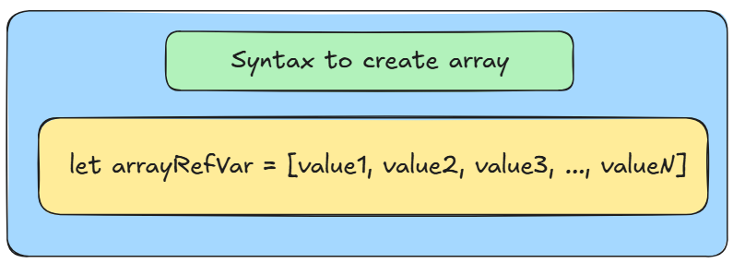
How to create array in javascript
We can create array by using Array Literal ([ ]).
The most common and straightforward way to create arrays is by using array literals.

Slide 48
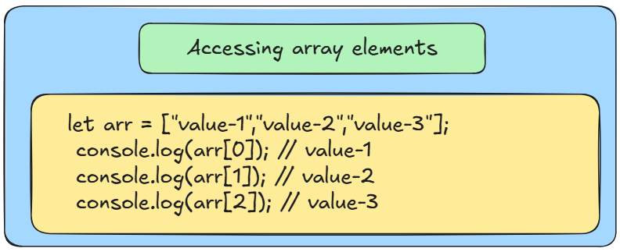
Accessing Elements of an Array
We can access array elements by using their index value.

Slide 49
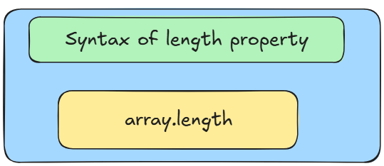
Array – length property
length: The length property of an array in javascript returns the numbers of elements in the array. (count)

Slide 50
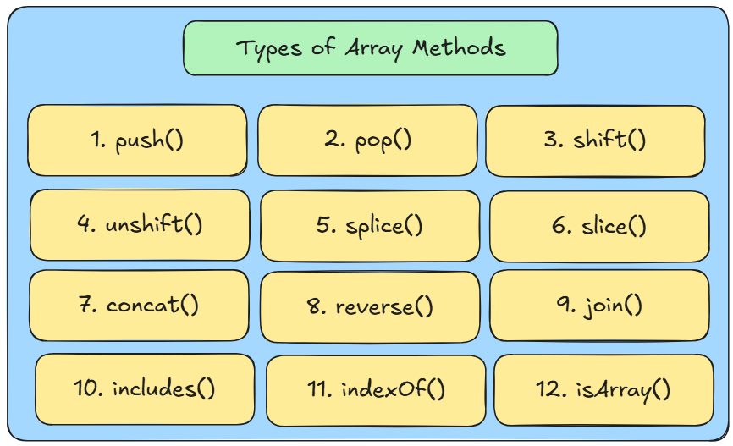
Array Methods in javascript

Slide 51
array Methods in javascript
push(): Adds one or more elements to the end of an array and returns the new length of the array.
Syntax - array.push(ele1, ele2, ele3, …., eleN);
2. pop(): Removes the last element from an array and returns it.
Syntax - array.pop();
shift(): Removes the first element from an array and returns it
Syntax - array.shift();
unshift(): Adds one or more elements to the beginning of an array and returns the new length of the array.
Syntax - array.unshift(ele1, ele2, ele3, …., eleN);
slice(): Removes the array elements according to the starting index and ending index.
Syntax - array.slice(startIndex, endIndex);

Slide 52
array Methods in javascript
6. splice(): Changes the contents of an array by removing, replacing, or adding elements.
Syntax - array.splice(startIndex, deleteCount, ele1, ele2, …eleN); [separator – “”, “ “, “ “]
7. concat(): Merges two or more arrays into a new array
Syntax - array.concat(array1, array2, array3,….arrayN);
8. reverse(): Reverses the order of elements in an array.
Syntax - array.reverse();
9. join(): Joins all elements of an array into a string, separated by a specified separator.
Syntax - array.join(separator);
10. includes(): Determines whether an array includes a certain element.
Syntax - array.includes(searchElement, fromIndex);

Slide 53
array Methods in javascript
11. indexOf(): Returns the first index of a specified element in the array, or -1 if not found.
Syntax - array.indexOf(searchElement);
12. isArray(): The Array.isArray() method checks if a given value is an array or not.
Syntax - Array.isArray(array);

Slide 54
DAY-04
Topics Covered : –
Objects in Javascript
What is an object?
How to create an object?
How to access an object?
Object Methods
Keys()
Values()
Entries()
Advanced Array Methods
map()
filter()
reduce()
Destructuring
Array Destructuring
Object Destructuring
Spread and Rest Operator
JSON

Slide 55
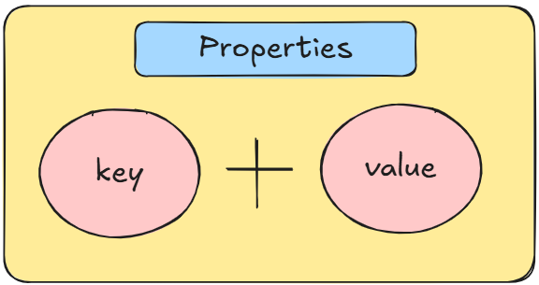
Objects in javascript
Object: An object is a programmatical representation of real-life entity.
In simple words we can say that object is a collection of multiple different properties in the form of a key-value pairs.
Property: It is the combination of key and value pair.
Where internally all the keys are stored in the form of string.
When you console (print) an object, the keys might not appear in the order you added them.
Objects properties does not follow any specific order.

Slide 56
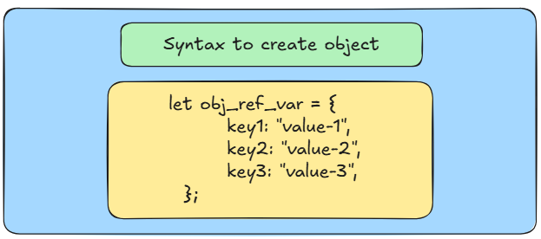
How to create object in javascript
We can create object by using Object Literal ({ }).

Slide 57
How to access object properties
There are 2 ways we can access the object properties:
1. By Using Dot (.) Notation :
The dot notation is the most common way to access properties, but it doesn't work for special keys.
2. By Using Square Bracket ([ ]) Notation:
The bracket notation is used when:
The key is dynamic.
The key has special characters or spaces.
The key consist of only number

Slide 58
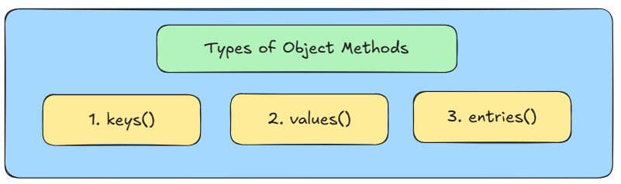
Objects methods in javascript
1. keys(): The Object.keys() methods returns an array with the keys of an object.
Syntax - Object.keys(obj);
2. values(): The Object.values() methods returns an array with the values of an object.
Syntax - Object.values(obj);
3. entries(): The Object.entries() methods returns each key and value pair in the form of array.
Syntax - Object.entries(obj);

Slide 59
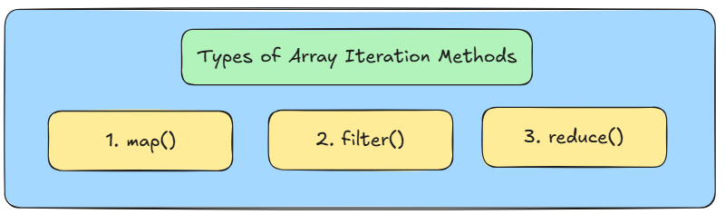
Advanced array methods (Iteration methods)
Q. What are Array Iteration Methods?
Array iteration methods are built-in functions that allow us to loop through arrays and perform specific operations on each element.

Slide 60
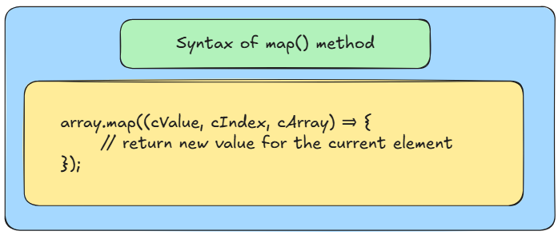
1. map()
map(): The map() method creates a new array by applying a given function to every element in the array.
It does not modify the original array.
Instead of it will create a new array.

Slide 61
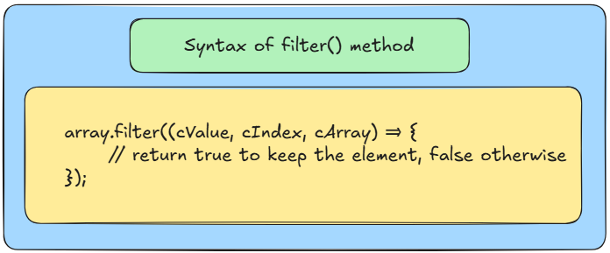
2. filter()
filter(): The filter() method creates a new array containing all the elements that pass a certain condition.
If the callback function returns true for an element, that element is included in the new array; otherwise, it is excluded.
It will return a new array containing elements that satisfy the condition.

Slide 62
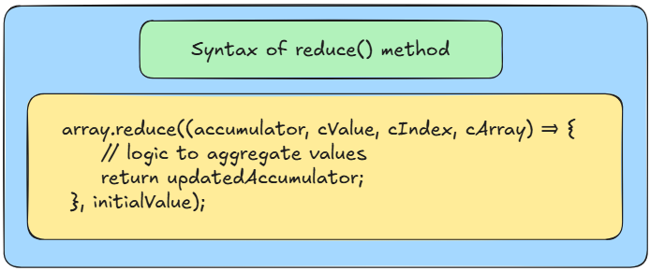
3. reduce()
reduce(): The reduce() method executes a reducer function on each element of array, resulting in a
single output.
The callback function takes four arguments: accumulator, currentValue, currentIndex, and the array itself.
Ideally it is used for sum, product or other computation.

Slide 63
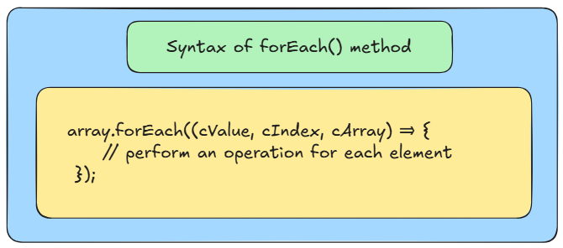
4. foreach()
ForEach(): The forEach() method executes a provided function once for each array element.
It does not return a new array it will modify the original array.
It does not return anything. (undefined)

Slide 64
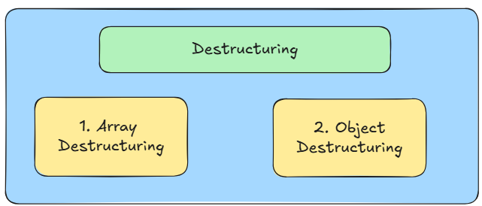
Destructuring in javascript
Destructuring: Destructuring means breaking a big structure like an array or object into smaller pieces (variables) easily.
In simple words destructuring means to break down the complex structure into simpler parts.

Slide 65

1. Array Destructuring
Array Destructuring: Destructuring helps us to extract the elements from the arrays and store inside variables.

Slide 66

2. Object Destructuring
Object Destructuring: It is used to extract the properties of an object and bind them to variable for ease use.
Extracts values from objects and assigns them to variables.
Important Note: In object destructuring we have to pass the actual key names as a variables.

Slide 67
rest parameter
1. Rest Parameter:
It will collects all remaining parameters in an array.
The rest parameter is used when defining a function to gather all remaining arguments into an array.
This allows you to handle an indefinite number of arguments.
It is used inside a function definition.
Rest Parameter - Left Hand Side of the equation or in Function Definition it is consider as the Rest Parameter.
Syntax: (…ref_var)

Slide 68
Spread Operator
2. Spread Operator:
The spread operator is used to spread or unpack the elements of an array (or object) into individual elements.
It is used inside a function call, or when copying arrays/objects.
Spread Operator - Right Hand Side of the equation or in function call.
Syntax: (…ref_var)
Example: Arrays, Objects, etc.

Slide 69
JSON
JSON: JSON stands for Javascript Object Notation.
It is a format for structuring data
It represents data as key-value pairs and supports data structures like objects and arrays.
Key Terms:
Collection: A collection of documents.
Document: A collection of fields (fields are key-value pairs).

Slide 70

How to Create JSON?
Rules for JSON:
Data is represented as key-value pairs.
Keys must be strings enclosed in double quotes.
Values can be strings, numbers, objects, arrays, booleans, or null

Slide 71

JSON methods in javascript
There are 2 main popular JSON methods used widely:

Slide 72

JSON methods in javascript
1. JSON.parse():
JSON.parse() converts a JSON string to a Javascript object.
It accepts a JSON string as a input.
When receiving data from a web server, the data is always a string.

Slide 73

JSON methods in javascript
2. JSON.stringify():
JSON.stringify() converts a JSON object to a Javascript strings.
It accepts a JSON object as a input.
When sending data to a web server, the data has to be a string format.

Slide 74
DAY-05
Topics Covered : –
JS Modules
Synchronous and Asynchronous JS
Timing Functions
setTimeout()
setInterval()
clearTimeout()
clearInterval()
Fetch API
Async and Await
BOM
Window Object
Window Methods
alert(), prompt(), confirm()
Local Storage
Session Storage

Slide 75

Javascript Modules
JS Modules:
Modules are a way to split and organize JavaScript code into smaller, reusable pieces.
Instead of writing all the code in one large file, you can break down it into smaller files (modules) and then import/export functionalities between them.

Slide 76

How to make js files as modules
By default, browsers do not treat JavaScript files as ES6 modules.
When working with ES6 modules in the browser, you need to specify type="module" in your <script > tag.

Slide 77

1. Default Export and import
A module can have only one default export.
You donʼt need to use {} curly braces when importing it.

Slide 78

2. Named Export and import
You can export multiple items from a module using named exports.
When importing, you must use the exact name inside curly braces {}

Slide 79

Difference between Synchronous and asynchronous js

Slide 80

Timing functions in javascript
What is Timing Functions in JS?
Timing functions in JavaScript allow us to execute a block of code after a certain delay or repeatedly after specific time intervals.
Timing functions essential is used for creating asynchronous tasks in our program.

Slide 81

1. setTimeout()
The setTimeout() executes the function once after a specified delay (in milliseconds).
The setTimeout() is executed only once.
Use case: Perform a task after some time (e.g., showing a message after 2 seconds).

Slide 82

2. setInterval()
The setInterval() executes the function repeatedly at specified time intervals (in milliseconds).
Use case: Perform tasks repeatedly (e.g., updating a countdown or clock).

Slide 83


3. clearTimeout() and 4. clearInterval()
3. clearTimeout(): The clearTimeout() stops a timeout set by setTimeout().
Use case: Cancel a delayed task if it's no longer needed.
4. clearInterval(): The clearInterval() stops a repeating task set by setInterval().
Use case: Stop a repeated action when a condition is met.

Slide 84
PROMISES IN JAVASCRIPT
What is a Promise?
A Promise in JavaScript is an object that represents the eventual completion or failure of an asynchronous operation and its resulting value.
The Promise Object represents the completion or failure of an asynchronous operation and its results.
States of a Promise:
Pending: The promise is in its initial state, neither fulfilled nor rejected.
Fulfilled: The promise is successfully completed, and the resulting value is available.
Rejected: The promise failed, and an error or reason is available.
Settled: A promise is said to be settled when it is either fulfilled or rejected, but not pending anymore.

Slide 85

FETCH API IN JAVASCRIPT
What is the Fetch API?
The fetch API is a modern way provided by browsers to fetch resources from servers (like APIs, files, etc.).
It allows you to make network requests and retrieve data (e.g., JSON data from an API or a webpage).

Slide 86
HOW TO HANDLE THE PROMISE
Fetch API will return you a Promise based response.
For handling promise we need to use async and await keyword.
async : The async keyword is used to declare a function that always returns a Promise.
The returned promise can resolve (fulfilled) or reject, depending on the outcome of the function.
await: The await keyword makes the function pause execution until the promise is resolved (fulfilled or rejected).
Important Note: It can only be used inside an async function

Slide 87

How to Use the fetch API

Slide 88
BOM IN JAVASCRIPT
What is BOM?
The BOM stands for Browser Object Model in Javascript.
The Browser Object Model ( BOM ) refers to the set of objects provided by the browser to interact and manipulate the browser window.
There are 2 main BOM objects are there:
window Object : The main global object representing the browser window/tab.
document object : Represents the HTML document loaded in the window.

Slide 89
BOM METHODS
1. window.alert(): The window.alert() method allows you to show the pop-up dialog containing the message, warning, etc. It takes the string text as an argument.
2. window.confirm(): It displays a confirmation box with “Ok” (true) and “Cancel” (false).
3. window.prompt(): Displays a dialog box that takes the inputs from the user.
4. window.open(): Opens a new browser window or tab. Syntax: window.open(url, target)
5. window.close(): Closes the current window (only works if the window was opened using JavaScript).

Slide 90
WEB STORAGE API
Web Storage API: Web storage API is allow us to store data in the browser itself.
It will provide us two main storage types:
Local Storage
Session Storage
Local Storage:
Local Storage stores data with no expiration time.
The data remains in the browser even after you close and reopen it.
Session Storage:
Session Storage stores data only for the current session.
The data is deleted/cleared when you close the browser or the tab.

Slide 91



1. LOCAL STORAGE
How to store data inside the local storage?
We can store, retrieve and remove the data with the help of 3 methods: setItem(), getItem(), removeItem()

Slide 92



2. SESSION STORAGE
How to store data inside the session storage?
We can store, retrieve and remove the data with the help of 3 methods: setItem(), getItem(), removeItem()

